Slide 1
The Quickstep Model
Hardy Hanappi
Ad personam Jean Monnet Chair for Political Economy of European Integration
Economics, TU Vienna
hanappi@tuwien.ac.at
EAEPE Conference 2012 in Cracow

Slide 2
Overview
Motivation
Three Roots of Quickstep
The Structure of Quickstep
The Role of Simulation and Game Theory
Conclusions for European policy

Slide 3
Three Roots of Quickstep
Keynes‘ Macroeconomics
Circular flows
Marx‘ Political Economy
Exploitation
Schumpeters‘ Innovation Idea
Sectoral disequilibrium

Slide 4
Keynesian Roots
S
B
GE
Accounts
H^{S}
H^{FC}
H^{L}
H^{FO}
D
F
Monetary flows in a closed economy

Slide 5
Marx‘ Dialectic of Progress
TIME
Money
Credit
Capital
Symbol-lead Actions
Exploitation
Increase in productivity and welfare

Slide 6
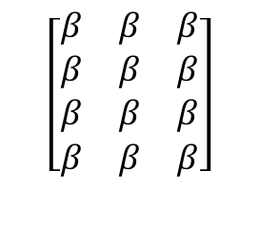
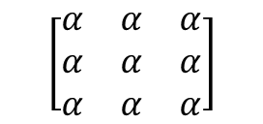
Schumpeter‘s heterogenous Dynamics
Matrix of technical coefficients
$$\left[\begin{matrix}α & α & α \\ α & α & α \\ α & α & α\end{matrix}\right]$$
$$\left[\begin{matrix}β & β & β \\ β & β & β \\ \begin{aligned}β \\ β\end{aligned} & \begin{aligned}β \\ β\end{aligned} & \begin{aligned}β \\ β\end{aligned}\end{matrix}\right]$$
Physical World
World of Internal Models

Slide 7
The Structure of Quickstep 1
Stocks and Flows of Money at Bank Accounts
H^{L}
i_{L}^{S} $∙$ S_{L}
B
F
0
i_{F}^{C} $∙$ D_{F}
H^{FO}
i_{FO}^{S} $∙$ S_{FO}
0
i_{FC}^{S} $∙$ S_{FC}
0
H^{FC}
S
0
i_{S}^{S} $∙$ S_{S}
H^{S}
i_{S}^{C} $∙$ D_{S}
0
0

Slide 8
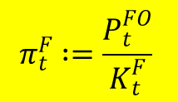
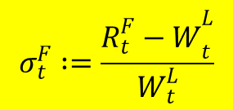
The Structure of Quickstep 2
Examples
$R_{t}+{(DB}_{t}^{F}−{DB}_{t+1}^{F})= P_{t}^{FO}+W_{t}^{L}+T_{t}^{F}+i_{t}^{F,C}∙{DB}_{t}^{F}$
$$π_{t}^{F}∶=\frac{P_{t}^{FO}}{K_{t}^{F}}$$
$$σ_{t}^{F}∶=\frac{{R_{t}^{F}−W}_{t}^{L}}{W_{t}^{L}}$$
$${Pgm}_{t}({ α}_{t}^{i, j}, l_{t}^{k, j})=\left\{\begin{matrix}{Pgm}_{t−1}\left({ α}_{t−1}^{i, j}, l_{t−1}^{k, j}\right) if {Inno}_{t}≤0 \\ {Pgm}_{t}^{∗}\left({ α}_{t}^{∗,i, j}, l_{t}^{∗,k, j}\right) if {Inno}_{t}>0\end{matrix}\right\}$$

Slide 9
The Role of Simulation and Game Theory
Exploring Trajecories instead of Discovering Laws
Making the Modelling of Internal Modelling explicit
Forces to work with Irreversible Time and (Capacity) Limits
Enables Changes in the set of Essential Variables

Slide 10
Thank you for your attention !
A very demanding research program!
☞
Recent Papers:
Can Europe survive? 
Shangri La Governance 
Money, Credit, Capital and the State 
Gramsci meets Veblen: On the search for a new revolutionary class 
Download:
http://www.econ.tuwien.ac.at/hanappi/publications.html
Conclusions for European policy

Slide 11
Some data

Slide 12
Some data

Slide 13
Some data

Slide 14
Some data

Slide 15
Some data

Slide 16
Some data

Slide 17
Some data

Slide 18
Some data

