Slide 1
A Vision for Europe: No Unemployment
Hardy Hanappi
Ad personam Jean Monnet Chair for Political Economy of European Integration
Email: hanappi@econ.tuwien.ac.at
Homepage: http://www.econ.tuwien.ac.at/hanappi
Institute for Mathematical Methods in Economics
Vienna University of Technology

Slide 2
Overview
Motivation
Sequence of causation
European Union and Employment Policy
A new policy proposal
On visions, emancipation, and European unification

Slide 3
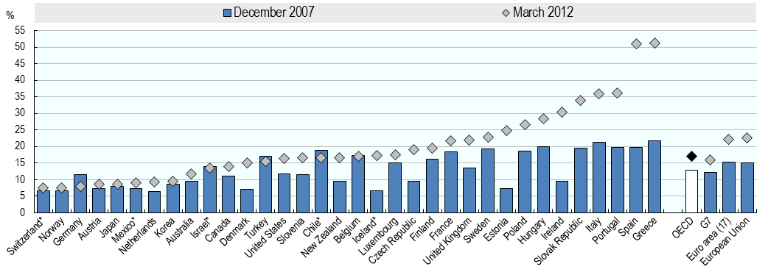
Motivation
Unemployment in
Mediterranean EU Countries
Youth unemployment rates

Slide 4
Sequence of causation
Searching the roots:
Firms and public institutions
reduce employment
TNCs shift production
and administration personell
Expected demand
of SMEs decreases
Austerity policy
Rising government debt
Bailout of banks
Speculative interest rate
attacks
No increases in labour productivity
In sight in OECD countries
Unrealistic financial promises
at global financial markets
☞
Impasse of the mode of production!

Slide 5
European Union and Employment Policy 1
The unification project originated with the intention to support
European TNCs with a common European political agency – with no explicit social policy component.
Basic assumption: Employment follows capital accumulation automatically, GDP growth breeds jobs (and with some pressure from SD even real wage growth).
☞
There was no employment policy!

Slide 6
European Union and Employment Policy 2
The emancipation of Europe‘s democratic governance takes place by the enforcement of the implementation of certain types of „social policy“, e.g. employment policy, a democratic governance of financial intermediaries (first step: banking union?), etc. .
The central question is how to organise a democratic force that can exert power on EU decision-makers. Several elements – class structure, class dynamics, alienation processes, coalition options, etc. – have to be considered. Proposal: Think of a Global Class of Organic Intellectuals (Gramsci) .
☞
Proposals and blueprints for emancipatory policy are needed NOW!

Slide 7
A new policy proposal 1
The sequence of actions with respect to employment decisions has to be inverted: achievement of profits (= growth) on firm level is subordinated to full employment of the workforce on a European level. With a large share of private ownership of means of production this implies a public employment initiative (for infrastructural tasks).
To implement an effective EU policy fighting unemployment in the Mediterranean EU countries it is mandatory to circumvent the interrupting and diverting intermediating levels on national and on firm level. One possibility is to found European Employment Agencies (EEAs) in Lisbon, Madrid, Rome, and Athens.
☞
New institutional solutions that circumvent the national ruling class.

Slide 8
A new policy proposal 2
A newly founded Labour Organization Task Force (LOTF) identifies the characteristics of the unemployed (1), identifies which infrastructural necessities (2), and surveys the different national institutional settings concerning labour organization (3). It also works on the design of anti-bureaucracy measures and mechanisms of democratic decision making.
The finance of the EEAs and the LOTF is provided directly by the European Central Bank. The success of an EEA is measured in direct relation to the reduction of the national unemployment rate. Since the European Union is in a position to produce the money Eurozone countries use, there is no direct limit to the increase of money supply (credit). Indirect effects, e.g. depreciation of the Euro, have to be observed.
☞
An important new role for the ECB as a part of European democracy.

Slide 9
On visions, emancipation, and European unification
A progressive (class) movement is organised along a vision. The implicit vision and historical mission of capitalism was growth of labour productivity. In Europe this old mission is vanishing.
A pilot project Europe should have as vision that it solves the employment problem, ensures the reproduction of more equally distributed welfare levels, and uses its TNCs to spread the democratic advantages of its new political economy.
☞
The emancipation of the EU has to be embedded in its global role

Slide 10
Supplementary Texts
Thank you for your attention
Hanappi H., 2010, The Beat of Visions. The challenging features of a new global mode of production.
Hanappi H., 2012, Shangri-La Governance. A Sketch of an Integral Solution for European Economic Policy based on a Synthesis of Europe's Problems.
Hanappi H. and Hanappi-Egger E., 2013, Gramsci meets Veblen: On the search for a new revolutionary class.
Hanappi H., 2013, Can Europe Survive? Ten Commandments for Europe’s Next Ten Years.
Hanappi H., 2013, Money, Credit, Capital, and the State, On the evolution of money and institutions.
Hanappi H., 2014, Evolutionary Dynamics in Revolutionary Times.
Hanappi H., 2014, South-East Europe in Evolution.
Hanappi H., 2014, Evolutionary Political Economy in Crisis Mode.
Hanappi H., 2014, Bridges to Babylon. Critical Economic Policy: From Keynesian Macroeconomics to Evolutionary Macroeconomic Simulation Models.
Hanappi H., 2014, Defeating Nationalism in Europe. Voting mechanisms for highly integrated economies
☞
All available at www.econ.tuwien.ac.at/hanappi/publications.html

