Slide 1
Europe – in 5 years
Hardy Hanappi
University of Technology of Vienna (Austria)
www.econ.tuwien.ac.at/hanappi/
hanappi@tuwien.ac.at

Slide 2
Overview
Major Challenges for Europe
An Utopian Solution in a Global Context
How to get from here to there
Some Open Questions

Slide 3
Europe‘s Problems
Unemployment
Capital Accumulation (“growth“)
War
Immigration
Environmental Limits

Slide 4
Unemployment
Two lines of attack:
Reduce weekly working hours
From 40h/week to 30h/week in 2020: plus 34 million jobs
for 43 million unemployed
Extend employment in the public sector
Restore the long-run trend to more infrastructure:
plus 9 million jobs necessary
With average EU wage (38K €) approximately 2.4% of
the current EU GDP (14000 bill €) are necessary.
diagrams

Slide 5
Capital Accumulation (“growth“)
Growth in capitalism is based
on labour productivity increase:
crisis
Reproductive innovation stimulated by the state replaces old style.
Falling Euro re-orients European TNCs to innovate for the 3rd world.

Slide 6
War
Strong increases in military expenditure, renewed
escalating conflict between NATO and Russia.
Necessity to develop an economic European policy
stance that secures peace on Europe‘s Eastern border.
Recommendations:
Two-country solution for the Ukraine.
Attractive economic policy for Eastern EU members to prevent
authoritarian nationalism (Russian style).

Slide 7
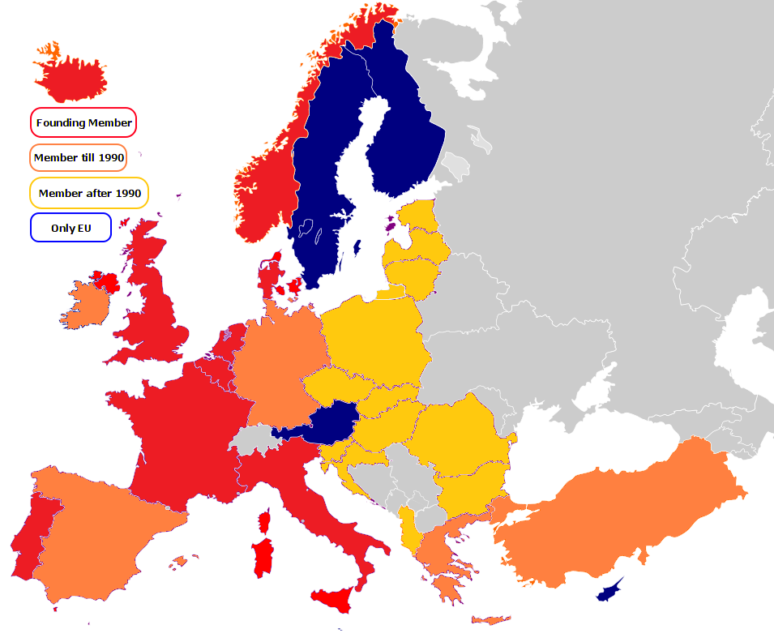
Nato Expansion - Territory

Slide 8
Nato Expansion - Money

Slide 9
Trade with Russia

Slide 10
Foreign Direct Investment Russia and EU

Slide 11
Immigration
Strict, unified and humanitarian procedures at Europe‘s
Southern borderline.
Additionally a positively oriented co-operation program
with African populations to help European TNCs to
produce for African consumers (pilote project Europe).
Recommendations:
Immediate stop of exports of the European weapons industries.
Support for anti-religious, enlightenment-oriented elites – student
exchange programs (training in social innovation).

Slide 12
Environmental Limits
Research in new energy producing and preserving
technologies (excluding nuclear energy) to enable
Europe‘s energy independence.
Active and conscious new culture development that
reduces alienation (e.g. excessive food or info-trash
consumption): a pivotal part of a pilote project Europe.
Recommendations:
No reversal of the German „Energiewende“.
Reassessment of transport systems, communication systems (information
pollution) and real estate allocation mechanisms.

Slide 13
An Utopian Solution in a Global Context
Europe has a constant population of 500 million people
Europe has found its place in the global division of labour (a knowledge breeder)
Europe‘s civilizing example allows to solve global conflicts without a global war.

Slide 14
How to get from here to there
From growth of population via growth of capital to growth of aggregate utility (welfare): Exploring new utility dimensions.
Clear priority for Europe‘s research and higher education sector. European research profile instead of weak copies of US approaches. Wake-up call for EU researchers.
Strong and central continental authority controlled by strong and federally structured democratic control of bureaucracy. Institutionalized civil conflict solution

Slide 15
Some Open Questions
How can a social group enforcing this utopia emerge?
Can Europe‘s second enlightenment be fast enough
to prevent escalating coercive (military) forces?
Which scientific and didactic methods will be needed
to be successful – internal and external communication?
Hope is to be found at the bottom of Pandora‘s Box
Thank you for your attention

