Slide 1
EUROPA? ZERFALL IN AUTORITÄRE NATIONALSTAATEN ODER FORTFÜHRUNG ÖKONOMISCH-POLITISCHER EINIGUNG
Hardy Hanappi
Ad personam Jean Monnet Professor für Politische Ökonomie der europäischen Integration
University of Technology of Vienna (Austria)
www.econ.tuwien.ac.at/hanappi/
hanappi@tuwien.ac.at

Slide 2
Überblick
Gründe für den Stillstand des Einigungsprozesses
Notwendigkeit eines visionären Zieles
Notwendigkeit konkreter Politikvorschläge
Offene Fragen

Slide 3
Gründe für den Stillstand
Globale Krise seit 2008
Verfall des Produktivitätswachstums
Globale Wertschöpfungsketten – extreme Interdependenzen
Zeitalter der Entfremdung - Ideologisierung
Fehlende demokratische Organisation der zentralen europäischen Institutionen

Slide 4
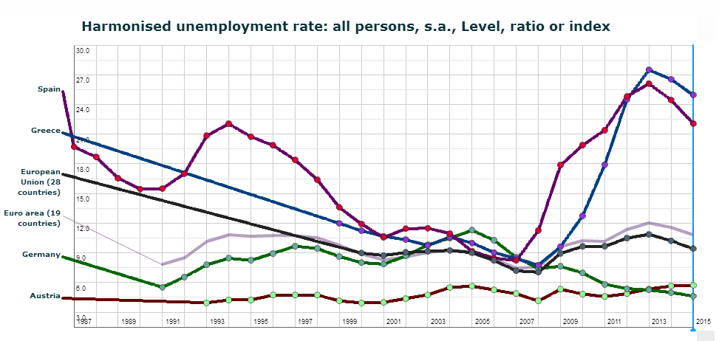
Beschäftigungskrise

Slide 5
Krise des BIP Wachstums
WW 1

Slide 6
Schuldenkrise

Slide 7
Sequence of causation
Searching the roots:
Firms and public institutions
reduce employment
TNCs shift production
and administration personell
Expected demand
of SMEs decreases
Austerity policy
Rising government debt
Bailout of banks
Speculative interest rate
attacks
No increases in labour productivity
In sight in OECD countries
Unrealistic financial promises
at global financial markets
☞
Impasse of the mode of production!

Slide 8
Produktivitätswachstum

Slide 9
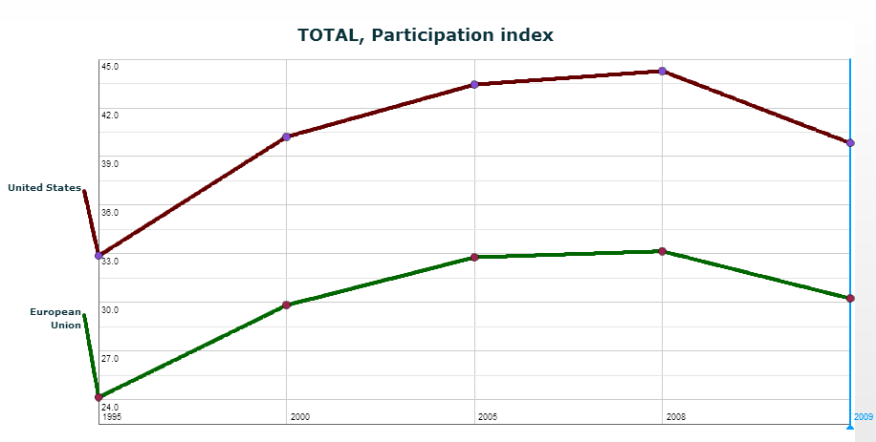
Globale Wertschöpfungsketten – extreme Interdependenzen

Slide 10
Zeitalter der Entfremdung - Ideologisierung
Notwendige Entfremdung - Arbeitsteilung
Religion und ideologische Manipulation als
Ersatz von Wissen
Bildungs- und Ausbildungsmisere
Zwiespältige Rolle der IKT
Zerstörung und Neuformation von
„Klassenbewußtsein“?
Eine neue globale Klassendynamik

Slide 11
From subsidiarity to network design - 1
Fehlende demokratische Organisation
Subsidiarity
Decision 1
Entity 1
Decision 2
Decision 3
Decision 4
Entity 2
Entity 3
Decision 5
Decisions are only transferred to higher level entities if they cannot be (better) performed at the lower level.
Decision 1
Decision 1
Decision 2
Decision 2
Decision 3
Decision 3
Decision 4
Decision 4
Decision 5
Decision 5

Slide 12
From subsidiarity to network design - 2
Problems with the Subsidiarity Principle in Political Economy
1. Two different types of entities:
Firms: maximize profit, capital accumulation (growth)
side constraint: reproduction
Political units: stabilize reproduction, welfare growth
side constraint: finance (including feasible debt)
2. Time horizons of feedback loops:
Firms: Innovation-banking-competion-cooperation-demand
Political units: Election cycles
3. Transnational Corporations versus local SMEs:
Political Counterpart of TNCs?
Political units as mediators between TNCs and SMEs?

Slide 13
From subsidiarity to network design - 3
Network design
Internal Model
Decision 1
Decision 2
Decisions become transitory negotiation results, agreed upon by agents with internal model-building.
Entity 1
Decision 3
Decision 4
Entity 2
Entity 3
Decision 5
…
Decision 1
Decision 1
Decision 2
Decision 2
Network (re-)design is supported by agent-based simulation in evolutionary political economy approaches.
Decision 3
Decision 3
Decision 4
Decision 4
Decision 5
Decision 5
…
…

Slide 14
Josef Schumpeter: Die Vision ist für die Organisation der politisch-ökonomischen Aktivitäten unverzichtbar!
Notwendigkeit eines visionären Zieles
Aber - T.W. Adorno: Die Vision erarbeitet sich ihre begriffe kontinuierlich an den praktischen Widersprüchen!
Notwendigkeit konkreter Politikvorschläge
☞

Slide 15
Immigration
Strict, unified and humanitarian procedures at Europe‘s
Southern borderline.
Additionally a positively oriented co-operation program
with African populations to help European TNCs to
produce for African consumers (pilote project Europe).
Recommendations:
Immediate stop of exports of the European weapons industries.
Support for anti-religious, enlightenment-oriented elites – student
exchange programs (training in social innovation).

Slide 16
Unemployment
Two lines of attack:
Reduce weekly working hours
From 40h/week to 30h/week in 2020: plus 34 million jobs
for 43 million unemployed
Extend employment in the public sector
Restore the long-run trend to more infrastructure:
plus 9 million jobs necessary
With average EU wage (38K €) approximately 2.4% of
the current EU GDP (14000 bill €) are necessary.

Slide 17
Environmental Limits
Research in new energy producing and preserving
technologies (excluding nuclear energy) to enable
Europe‘s energy independence.
Active and conscious new culture development that
reduces alienation (e.g. excessive food or info-trash
consumption): a pivotal part of a pilote project Europe.
Recommendations:
No reversal of the German „Energiewende“.
Reassessment of transport systems, communication systems (information
pollution) and real estate allocation mechanisms.

Slide 18
Capital Accumulation (“growth“)
Growth in capitalism is based
on labour productivity increase:
Reproductive innovation stimulated by the state replaces old style.
Falling Euro re-orients European TNCs to innovate for the 3rd world.

Slide 19
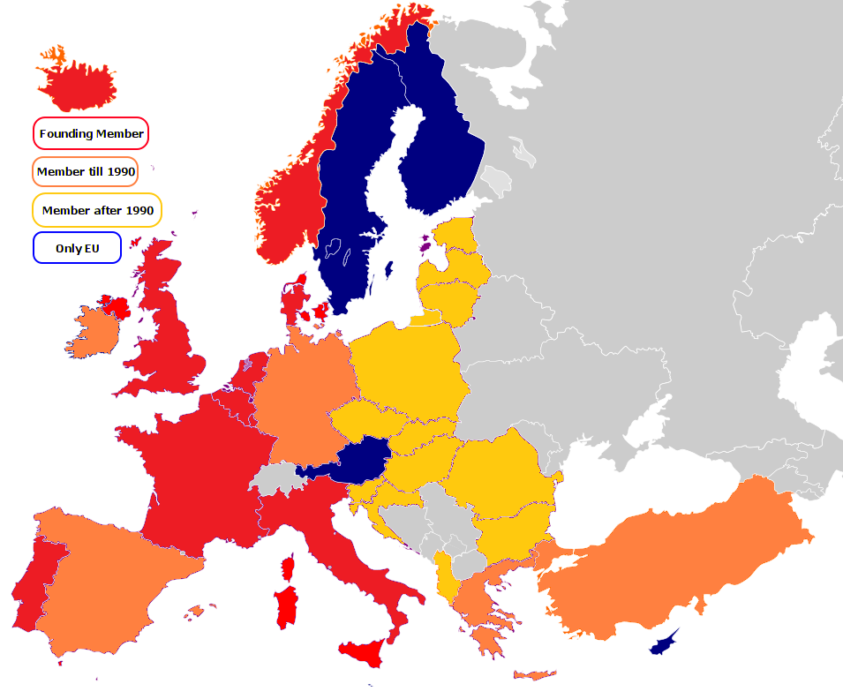
Nato Expansion - Territory

Slide 20
Nato Expansion - Money

Slide 21
Trade with Russia

Slide 22
Foreign Direct Investment Russia and EU

Slide 23
War
Strong increases in military expenditure, renewed
escalating conflict between NATO and Russia.
Necessity to develop an economic European policy
stance that secures peace on Europe‘s Eastern border.
Recommendations:
Two-country solution for the Ukraine.
Attractive economic policy for Eastern EU members to prevent
authoritarian nationalism (Russian style).

Slide 24
Zerfall Europas?
Vision

Slide 25
An Utopian Solution in a Global Context
Europe has a constant population of 500 million people
Europe has found its place in the global division of labour (a knowledge breeder)
Europe‘s civilizing example allows to solve global conflicts without a global war.

Slide 26
How to get from here to there
From growth of population via growth of capital to growth of aggregate utility (welfare): Exploring new utility dimensions.
Clear priority for Europe‘s research and higher education sector. European research profile instead of weak copies of US approaches. Wake-up call for EU researchers.
Strong and central continental authority controlled by strong and federally structured democratic control of bureaucracy. Institutionalized civil conflict solution

Slide 27
Some Open Questions
How can a social group enforcing this utopia emerge?
Can Europe‘s second enlightenment be fast enough
to prevent escalating coercive (military) forces?
Which scientific and didactic methods will be needed
to be successful – internal and external communication?
Hope is to be found at the bottom of Pandora‘s Box
Danke für Ihre Aufmerksamkeit

