Slide 1
Simulation of Class Transformations in an Age of Alienation
Hardy Hanappi
Ad personam Jean Monnet Chair for Political Economy of European Integration
University of Technology of Vienna, Economics
www.econ.tuwien.ac.at/hanappi/ hanappi@tuwien.ac.at

Slide 2
Structure of the topic
Motivation
Sharing some hopefully new ideas
A first pass through the triangle
Global Class Dynamics
Simulation
Age of Alienation

Slide 3
A first pass through the triangle
Simulation=Model ?
Models? Formalizing to explore essentials.
ENTITY
goals
perceive
From Kant to Wittgenstein 1 & 2.
Whose models? Simulations of simulations ...
Memory
MODEL
World
Arriving at von Neumann‘s game theory
perceive
explore
instruments
Which social entity? To see what essentials are possible.
Global Class Dynamics
Simulation
Age of Alienation

Slide 4
A first pass through the triangle
Primacy of the group.
Mirrors constitute the individual.
Shared models - communication.
Different positions in the world – classes.
Reflected in brains – class consciousness.
Global world – global classes.
Local interpretation looses contact to the global world
Global Class Dynamics
Simulation
Age of Alienation

Slide 5
A first pass through the triangle
Marx: Double alienation.
A1: Global division of Labour (necessary).
A2: Produced social value becomes capital.
Solving contradictory contradictions?
Today A3: ICT Industry produces consciousness!
Extreme volatility.
Eco‘s New Dark Age of despair – no progressive pragmatism?
But: Simulation provides mirrors.
Global Class Dynamics
Simulation
Age of Alienation

Slide 6
A second pass through the triangle
Second enlightenment by simulation.
French Enl. - Hegel – Marx - ...
Inversion, due to alienation A3.
Local and global obscuration.
Manipulation of a Mass of Minds - MMM!
Adorno: Negative Dialectics.
Simulation: Play the tune of frozen relations to make them dance?
Recent history of MMM: Nation, Race, Religion, even neoclassical economics.
Global Class Dynamics
Simulation
Age of Alienation

Slide 7
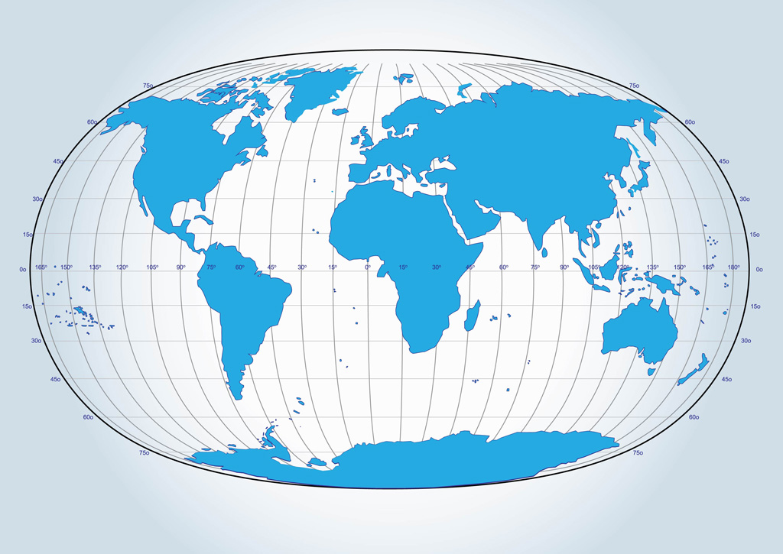
Classes Sharing Models
ENTITY
goals
perceive
ENTITY
goals
perceive
Memory
Memory
MODEL 2
World
MODEL 1
World
perceive
explore
perceive
explore
instruments
instruments
ENTITY
goals
ENTITY
goals
perceive
Memory
perceive
Memory
MODEL 1
perceive
explore
World
MODEL 2
perceive
explore
World
instruments
instruments

Slide 8
A second pass through the triangle
Volatility: Metamorphosis Model.
What are its elements?
Quick entry and exit of class fragments.
Basic ferment: INEQUALITY of ...
But: Root of prosperity is DIVERSITY!
Growth of shareholder value, or ...
... reproduction of the species?
Which class can organize metamorphosis?
Urgent need for a simulation of global class dynamics.
Global Class Dynamics
Simulation
Age of Alienation

Slide 9
A second pass through the triangle
Search for a soft landing of the species.
History shows pulsation dynamics.
Politics needs theory.
Phase transition models differ from crystalline growth models.
Learn simulation features from Quantum Theory !
E.g. enthalpy, order parameters
Continuous movement in the triangle to process dialectics.
Global Class Dynamics
Simulation
Age of Alienation

Slide 10
See my publications at http://www.econ.tuwien.ac.at/hanappi/publications.html
Major Tasks
Develop theory: Evolutionary Political Economy
Use theory to support the survival of the species
Thank You for your Attention

